Slide 1
HTML5 – The basics

Slide 2
What is HTML?
HTML stands for Hypertext Markup Language
Markup languages are not the same as programming languages, they use tags to annotate documents.
Tags indicate where headings, images, lists, links, line breaks, etc should go.

Slide 3
.html files
Your computer “knows” to open an .html file in a browser.
The browser can read this file (and others) and know how to render it.
Screen readers/assistive devices utilize the HTML tags to present the information as well.

Slide 4
Web Standards
No one “runs” the Internet or the Web, some groups do take proactive roles:
Internet Engineering Task Force (IETF)
World Wide Web Consortium (W3C)
The Web Accessibility Initiative (WAI)

Slide 5
Evolution of HTML
Year | Advancement
1993 | HTML 1.0-Developed by Tim Berners-Lee to link documents
1995 | HTML 2.0 - Developed by Internet Engineering Task Force RFC to include stylized text and tables
1996 | CSS 1
1997 | HTML 3.2–Developed by W3C and had browser specific features
1997 | HTML 4.0–A move back to normalizing across platforms.
1998 | CSS 2
1999 | HTML 4.01 – Introduced different document types

Slide 6
Where we are now
Established Guidelines
New features should be based on HTML, CSS, the DOM, and JavaScript
Reduce the need for external plugins (e.g. Flash)
More markup to replace scripting
HTML5 should be device independent

Slide 7
The Document Object Model (DOM)
Basis of HTML5 is “New features should be based on HTML, CSS, the DOM, and JavaScript…”
DOM provides common tree-like structure that all pages should follow
Computer Scientists love trees (the mathematical kind) because you can test them.

Slide 8
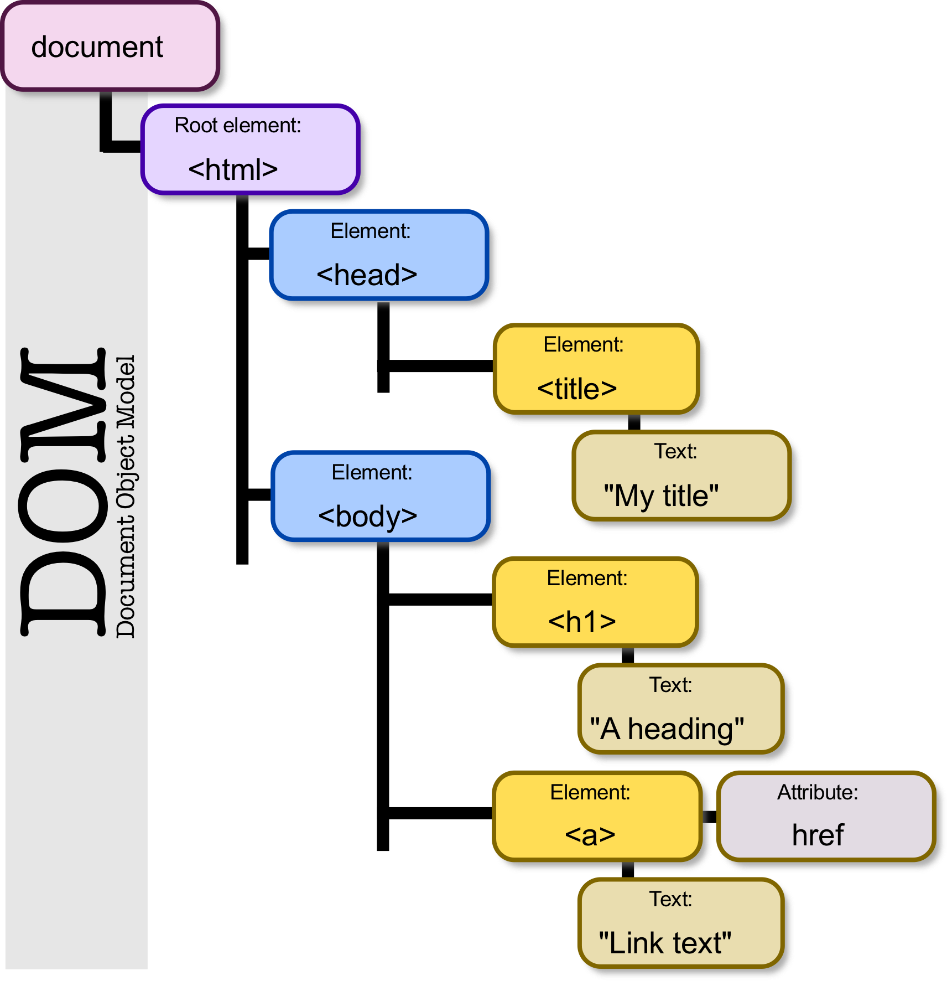
HTML is built on the DOM
The html tags is the root and has two children – the head and the body.
Image Source

Slide 9
Three parts of a well-formed document
Doctype
Version of HTML that you will be using
Head
Metadata
Body
Displayable content

Slide 10
Doctype
HTML5
<!DOCTYPE html>
Previous versions dictated backwards compatibility
<!DOCTYPE HTML PUBLIC "-//W3C//DTD HTML 4.01//EN" "http://www.w3.org/TR/html4/strict.dtd">
<!DOCTYPE HTML PUBLIC "-//W3C//DTD HTML 4.01 Transitional//EN" "http://www.w3.org/TR/html4/loose.dtd">

Slide 11
Head
Additional information used by the browser
Meta data – language, title
Supporting files – JavaScript, Styling, Add-ons
Typically, other than title and favicon the meta-data is not displayed

Slide 12
Body
Bulk of your page
Important to write well-formatted (tree-like) code.
Most of the content is displayed by the browser, but there may be some meta-data too!!

Slide 13
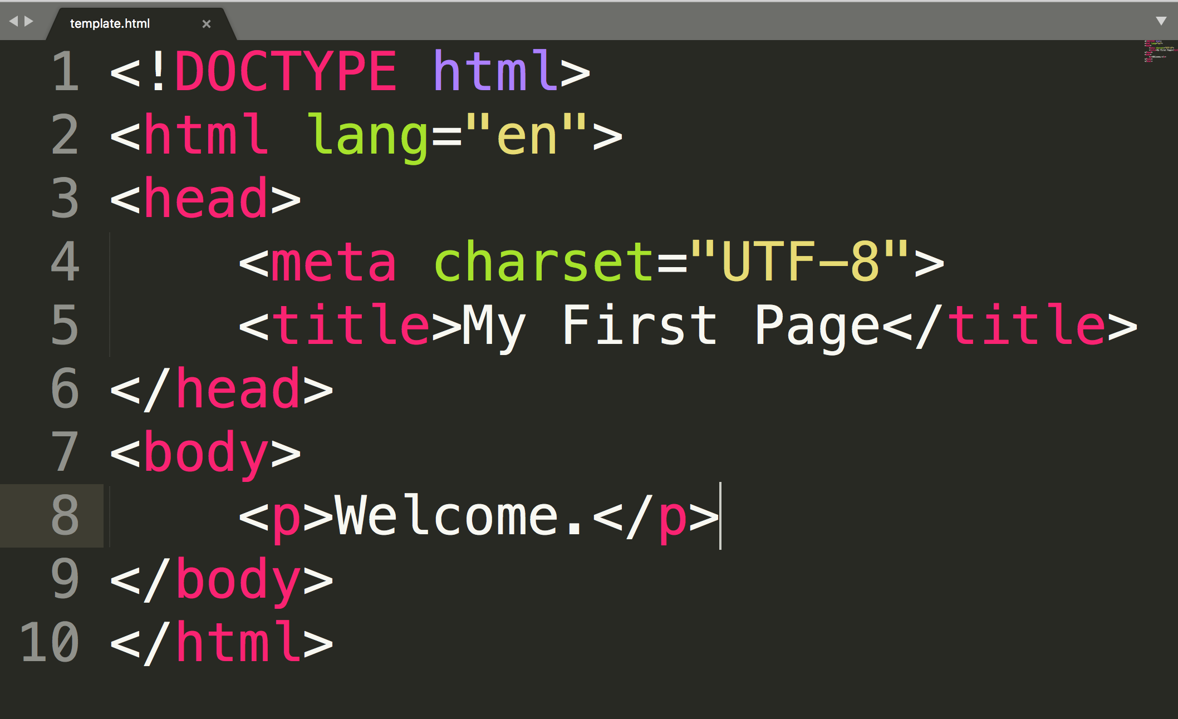
Example
The code in this image can be found in the alt text.

Slide 14
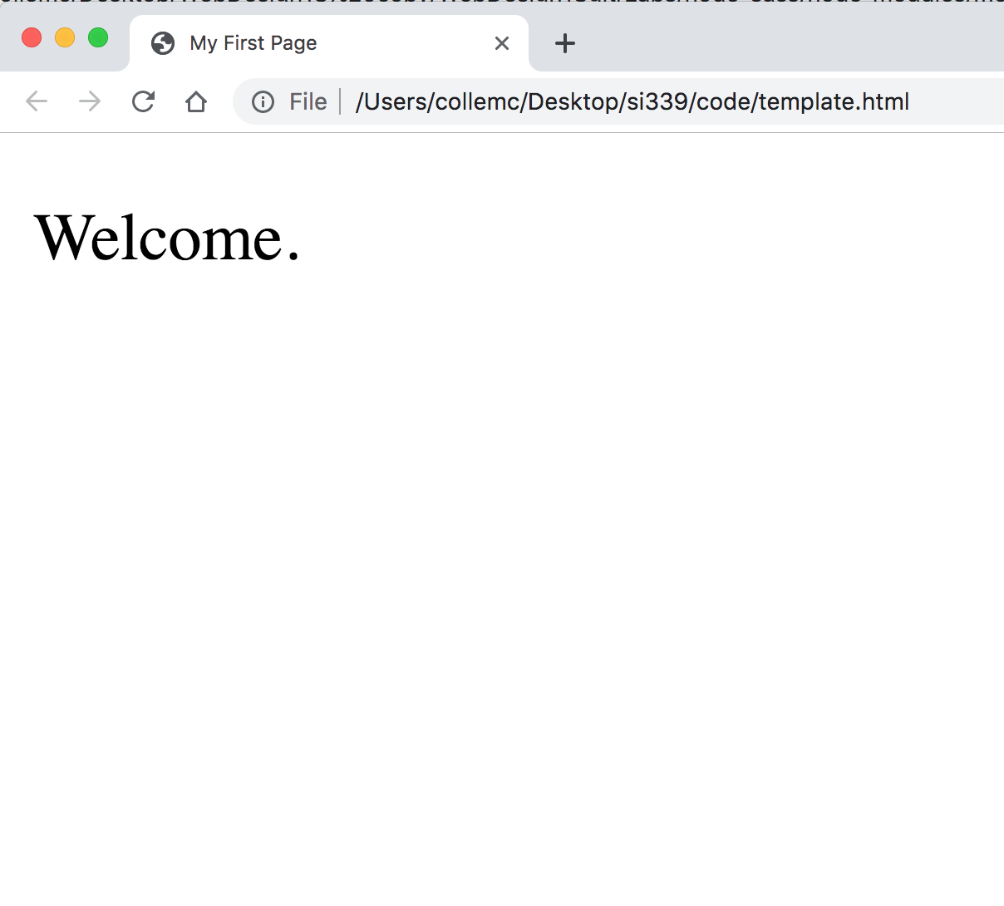
Example Results
Can you find the title?
Get in the habit of checking the URL.
Why is my text “bigger”?

Slide 15
Validate the Code
The browser will “hide” mistakes so always validate.
validator.w3.org
wave.webaim.org
aXe extension

Slide 16
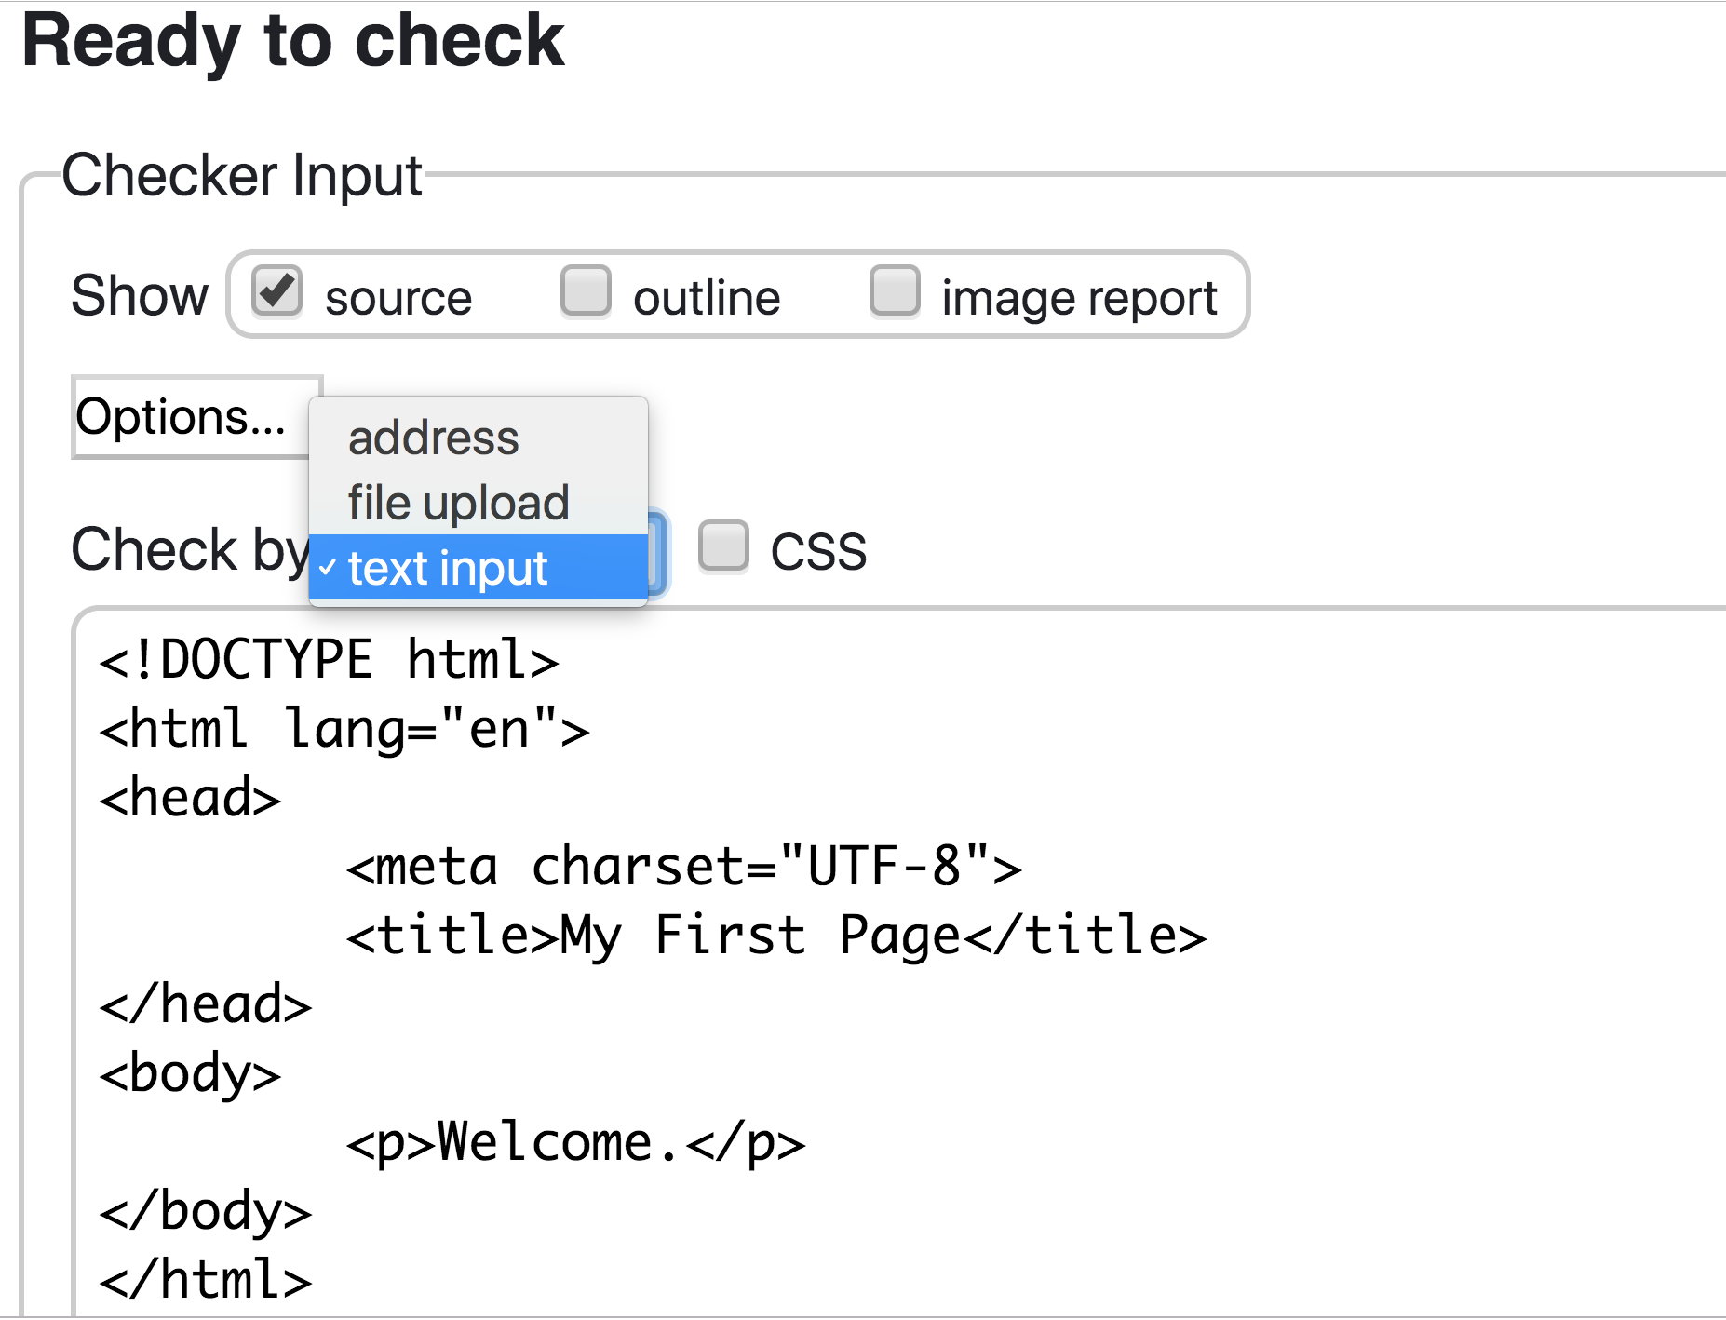
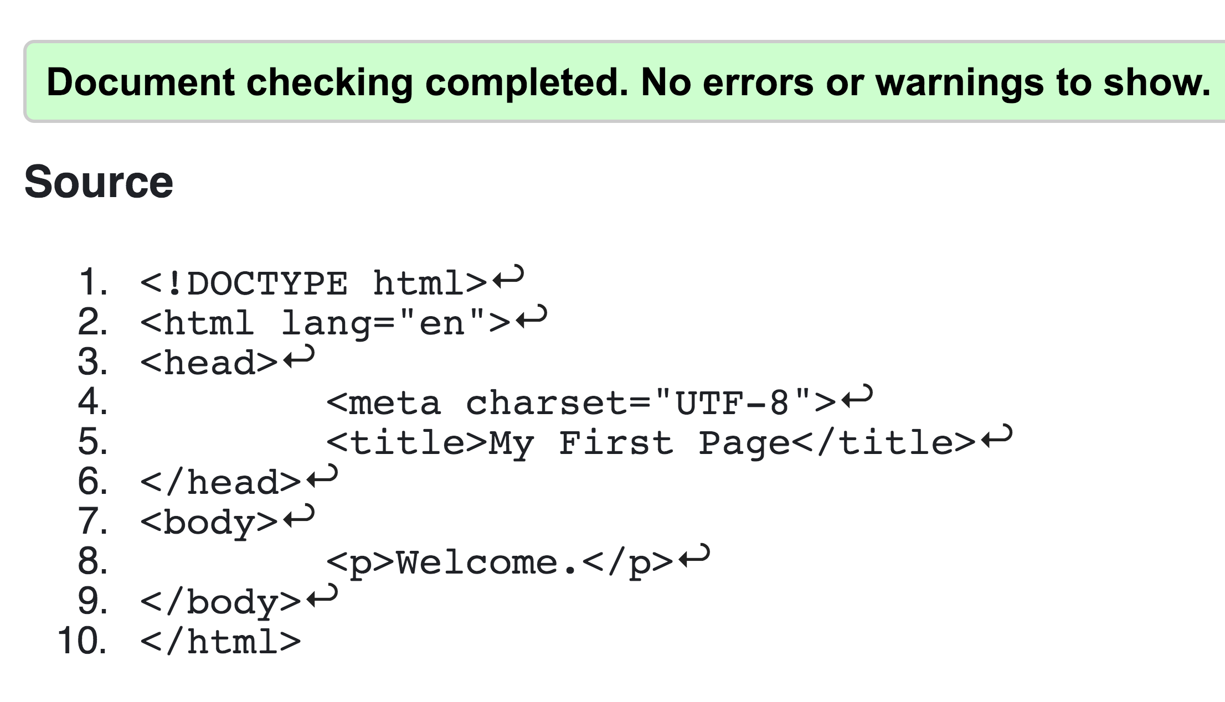
validator.w3.org
Warnings can be ignored, not errors!

Slide 17
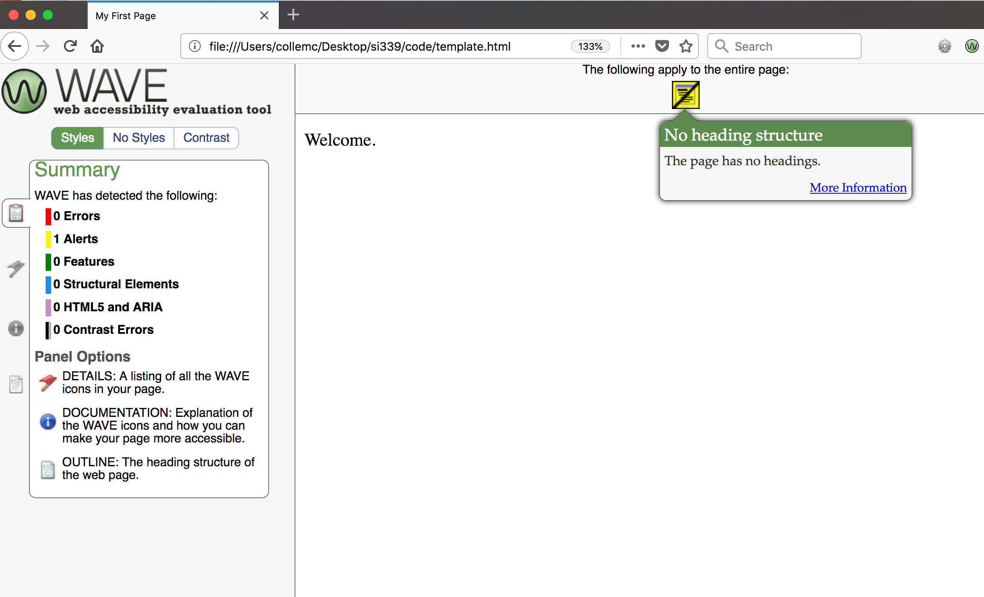
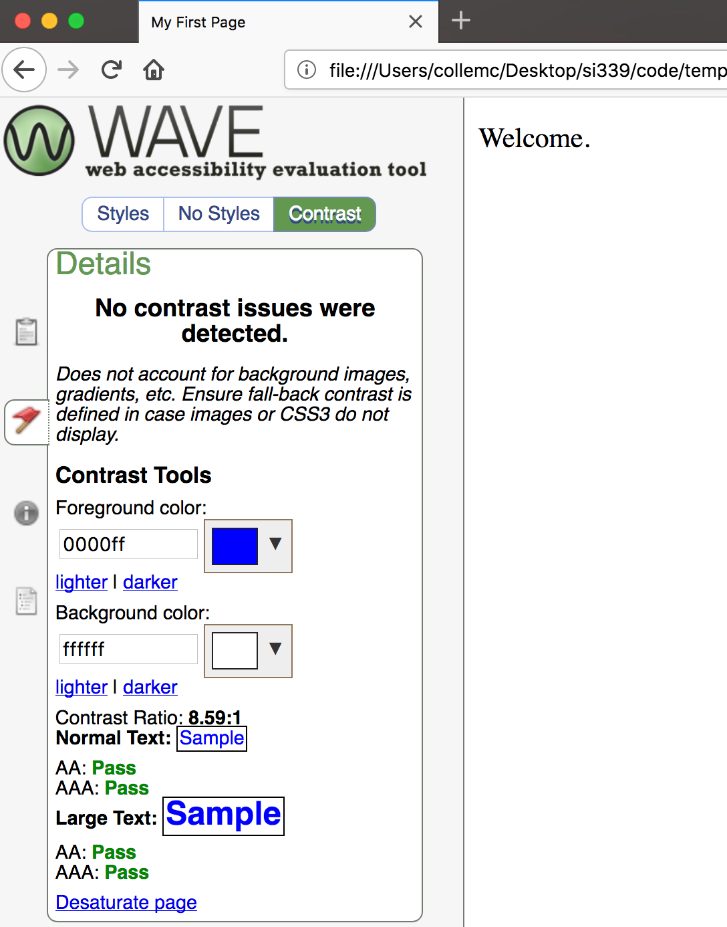
wave.webaim.org
Check for contrast issues
Check for Errors in the Styles

Slide 18
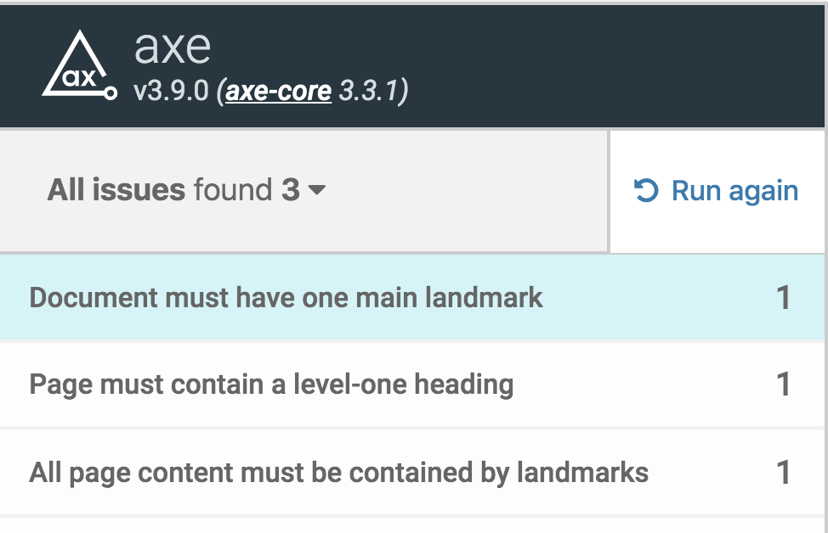
aXe
All of these issues should be addressed!

Slide 19
HTML tags
I can’t teach you all of the tags
I can’t teach you all of the tags
You don’t want me to teach you all of the tags

Slide 20
Finally, some tags…
Tags have a beginning and an end
Some tags have attributes (src, href, etc..)
<h1>Hello World</h1>
Start tag
Closing tag
<img src=“x.gif” alt=“lecture hall”/>
Self-closing tag

Slide 21
Common Tags
Headings (<h1> </h1> … <h6> </h6>)
These tags have syntax and semantics
Paragraphs (<p> </p>)
Should only contain inline elements
Divs (<div> </div>)
Generic section that is larger than a paragraph

Slide 22
Lists
Ordered lists (<ol> </ol>)
Unordered lists (<ul> </ul>)
Ensure every “child” is <li>
Indentation isn’t necessary, but helpful
<ul>
<li> Item One </li>
<li> Item Two </li>
</ul>
Line breaks
<br/>

Slide 23
Attributes
Attributes provide additional information about an element
Always specified in the start tag
Attributes come in name/value pairs unless they are Boolean.

Slide 24
Images
<img src=”logo.jpg” alt = "logo”
title = "A1 LLC" class ="thumbnail"/>
src and alt attributes are always required!!
alt attribute (can) be empty, but not in your autograded assignments

Slide 25
Notes on Images
Images rarely work the first time
Show a broken link, too big, too small, etc.
Save yourself heartache and size/carefully name your picture before you use it.

Slide 26
Note on Attributes
class – used to group HTML elements
id – used to identify specific element
style – specifies a certain visual style (do not use this!!!)
accesskey – a shortcut key to activate an element
tabindex – the order that the tab button brings elements into focus

Slide 27
Links
Links are what make the Web a web.
The interlinked nature of the web leads to the “knowledge” that search engines appear to have.
Links can be internal, external, absolute, relative, and graphical

Slide 28
Anchor links
The <a> tag stands for “anchor”
Links have one attribute within the tag AND need additional content
Attribute: reference to location of new content
Content is the “clickable” part, may be text or image.

Slide 29
Absolute reference
<a href="http://www.cnn.com/">CNN</a>

Slide 30
Relative References
<a href=“menu.html">Menu</a>
<a href=“docs/menu.html">Menu</a>
<a href=“#menu">Menu</a>

Slide 31
Absolute vs Relative
When would you use absolute links?
Are there any benefits to using local links?
Your links should NEVER have folders that are specific to your computer
C:\page2.html

Slide 32
Using Images as the Link
The “clickable” component doesn’t have to be text.
<a href=”http://www.linkedin.com">
<img src=“img/logo.png” alt = ”LinkedIn"/></a>
<a href=”http://www.linkedin.com"><i class="fab fa-linkedin-in” aria-label = ”LinkedIn”></i></a>

Slide 33
Usability Issues
Make sure the clickable component has an informative name
Information in the images should be available to those who can’t see the image using alt text or an aria-label attribute

Slide 34
Special Entities
Tags always start with a bracket (<)
If you want…. | Then use…
< | &lt;
> | &gt;
© | &copy;
blank space | &nbsp;
¢ | &cent;
& | &amp;

Slide 35
Using Semantic Tags
In the beginning (insert dramatic music of your choice…) there was <div>
Divs almost always had special classes/ids associated with them
<div class = “header”>…</div>
<div class = “navigation”>…</div>
<div class = “footer”>…</div>

Slide 36
<header>
A group of introductory or navigational aids: title, navigation links
Not to be confused with <head> or the different headings.

Slide 37
<nav>
A section of the page that links to other pages or to parts within the page.
Often found in the <header> tag
Often contains a <ul> tag
Use instead of <div role="navigation”>

Slide 38
<footer>
A section that contains info such as copyright data, related documents, and links to social media.
Typically at the bottom of the page, but not required.

Slide 39
<figure>
More semantic than <img/>. Can include captions and multiple multi-media resources.
<figure>
<img src=“img/hc.gif” alt = ”hot chocolate"/>
<img src=“img/latte.gif” alt = ”latte"/>
<img src=“img/chai.jpg” alt = ”chai"/>
<figcaption> Our menu items </figcaption>
</figure>

Slide 40
(Some) Other New HTML5 Tags
Structural Elements
article, aside, main, summary, section
Form Elements
datalist, keygen, output
Input Types
color, date, email, list
Graphics Elements
canvas, svg
Media Elements
audio, embed, source, track, video

Slide 41
“Notes”
Learn to Use Inspect Element – You will use it OFTEN
Get in the habit of using the validators
Don’t put your class files in a ”deep” folder structure. You will be accessing the files frequently.

Slide 42
“Learning” HTML
In the beginning you worry about syntax
How do I use tags?
Later, you will worry about semantics
Is there a tag that better conveys the meaning I am trying to get across?
If someone is searching my page can they find what they need and access it easily?

Slide 43
Odds and Ends
The Request/Response cycle
The importance of:
index.html and knowing your URL
Code organization – always know what file is being edited.
Tag display values – often block or inline
Adding extensions to your editor
Accessibility – you don’t get to decide what is/isn’t important

Slide 44
Acknowledgements
These slides are Copyright 2019- Colleen van and made available under a Creative Commons Attribution 4.0 License. Please maintain this last slide in all copies of the document to comply with the attribution requirements of the license. If you make a change, feel free to add your name and organization to the list of contributors on this page as you republish the materials.
Initial Development: Colleen van Lent , University of Michigan School of Information

